Slide 1
Ак- Суйский р/н с. Теплоключенка
Школа- гимназия им. С. М. Кирова

Slide 2
Unit 11 Lesson 1: We are having fun in the mountains. Theme: Present Continuous Tense.
Grade: 4
Subject: English
Level: Beginners
Teacher: Urkasymova Guliya Umbetovna

Slide 3
Aim of the lesson:
-The use of Present Continuous in the affirmative, negative
and interrogative sentences with the pronouns he, she, it, they, we, you, I.
Lesson Objectives:
-contribute to the formation of tolerance when working in pairs and groups;
cultivate respect for work
-use of learned vocabulary on the topic " We are having fun in the mountains“
in a speech;
- develop skills in all types of speech activity;
develop communication skills.

Slide 4
The Present Continuous Tense
Настоящее
продолженное
время

Slide 5
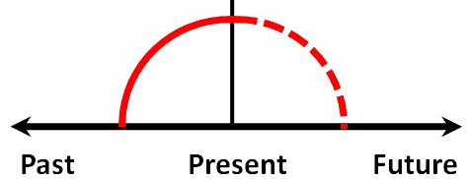
The Present Continuous Tense
Настоящее продолженное время
С помощью этого времени описываются события, которые происходят сейчас, в данный период времени.

Slide 6
Указатели времени
Now (сейчас)
At the moment (в данный момент)
At present (в настоящем)
Still (всё ещё)
Today (сегодня)
Nowdays (в наше время/ в наши дни)

Slide 7
The Present Continuous Tense образуется с помощью вспомогательного глагола to be в форме настоящего времени am/ is/ are + основной глагол с окончанием -ing.
I am
HE
SHE is + play + ing
IT
WE
YOU are
THEY

Slide 8
Самостоятельная работа
Добавь окончание –ing к следующим глаголам:
put, make, fly, go, stay, swim

Slide 9
Проверь себя
Put - putting
Make - making
Fly - flying
Go - going
Stay - staying
Swim - swimming

Slide 10
Образование
утвердительных предложений
Подлежащее + am/is/are + основной глагол + ing + второстепенные члены предложения
He is reading now – Он читает сейчас.

Slide 11
Образование
отрицательных предложений
Подлежащее + am/is/are + not + основной глагол + ing + второстепенные члены предложения
He is not reading now – Он не читает сейчас.

Slide 12
Образование
вопросительных предложений
am/is/are + подлежащее + основной глагол + ing + второстепенные члены предложения
Is he reading now – Он сейчас читает?

Slide 13
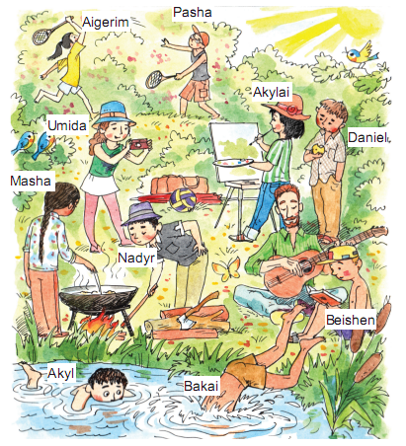
Закрепление пройденного материала.
1. Посмотрите на картину и поставьте глагол в правильной форме.

Slide 14
We are in the mountains. It’s very beautiful here.
The sun ___________.
is shining
The birds _________.
are flying
All children __________.
are having fun
Bakai and Akyl _________________ in the river.
are swimming
are playing
Pasha and Aigerim ____________ badminton.
Akylai _____________ a picture.
is painting
Nadyr and Masha ____________.
are cooking
Beishen __________ a book.
is reading
Daniel ________ an apple.
is eating
Umida is _________ photos.
Ben _________ the guitar.
taking
is playing

Slide 15
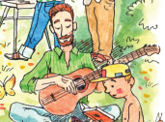
2. a) Look at the picture. Ask and answer the questions.
Example: What is Ben doing?
He is playing the guitar.

Slide 16
1. – What ____ Pasha and Aigerim _____?
are
doing
They are playing badminton.
2. ______ Umida _____________?
Is
taking photo
Yes, she is taking photo.
3.– ____ Nadyr and Masha __________?
are
cooking
Yes, they are cooking.

Slide 17
Look at the picture. Correct the mistakes in the sentences. Write two more sentences.

Slide 18
3. Look at the picture. Correct the mistakes in the sentences. Write two more sentences.
Akylai isn’t wearing a black skirt.
She is wearing blue jeans.
Акылай не носит чёрные брюки.
Или Акылай не в чёрных брюках.
Акылай в голубых брюках.
Или Акылай носит голыбые брюки

Slide 19
4. Write the questions and the short answers.
Example:
Is
your father
working
today?
Yes, he is.
1. your father / work / today / ? Yes, _______
2. you / have a good time / on holiday / ?
Are you having a good time on holiday?
Yes, we are
3. your mother / cook dinner / now / ?
Is your mother cooking dinner now?
Yes, she is
4. your baby sister/ sleep/?
Is your baby sister sleeping?
No, she is not
5. you/ do exercise / ?
No, we are not
5. Are you doing exercise?

Slide 20
Home task
Exercise 5. Page 162
Complete the dialogue. Write your answers.
Example: What book are you reading? I’m reading a
Harry Potter book.
1. a. I´m reading a book. b. What book ____________ ?
2. a. He’s cooking dinner. b. What ______________ ?
3. a. My sister is going on holiday. b. Where ________?
4. a. We aren’t sleeping. b. What ______________ ?
5. a. My mother isn’t at work today. b. What _________?

