Slide 1
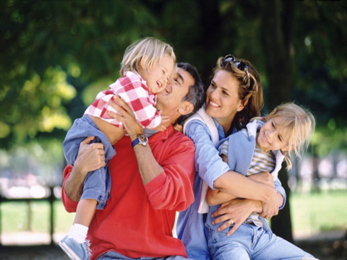
My family
Школа-гимназия им.С.М.Кирова Ак-Сууйского района
8-класс урок английского языка
Составила: учитель английского языка Самбаева М.Т.

Slide 2
Try to guess what we’ll talk today about.
This is my father.
This is my mother.
This is my brother Paul.
This is my sister.
This is my grandmother.
How I love them all.

Slide 3
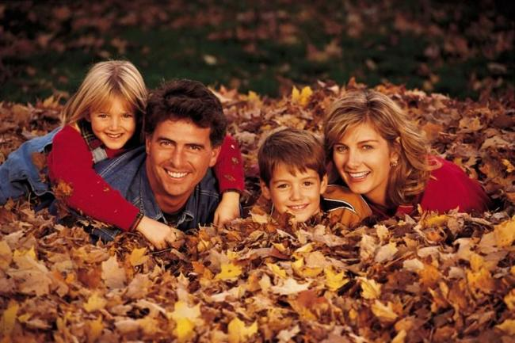
My family

Slide 4
Phonetic drill
grandmother
mother
daughter
elder sister
younger sister
aunt
cousin
niece
wife
grandfather
father
son
elder brother
younger brother
uncle
nephew
husband
parents

Slide 5
Give the opposites: A father –
a sister –
a dad –
a man –
an uncle –
a son –
a granddad –
many children –

Slide 6
Guess who they are.
my father and my mother are my…
my mother’s daughter is my …
my father’s mother is my …
my father’s brother is my …
my mother’s sister is my …
my aunt’s son is my …
the daughter of my brother or a sister is my…
the son of my brother or a sister is my …

Slide 7
Карта ассоциаций.
What is a family?
What associations have you with a word “family”?
What is a family for us?

Slide 8
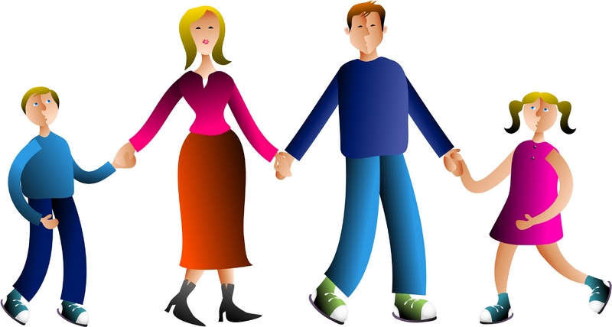
What is a family?

Slide 9
Baby and father and mother: a family, Parents and sister and brother: a family.

Slide 10
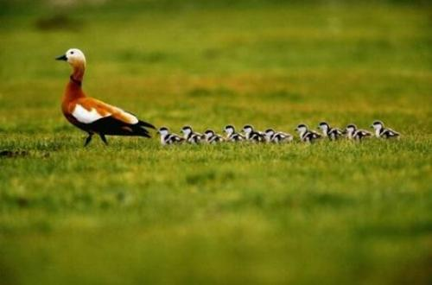
All kinds of people can make up a family,
All kinds of mixtures can make up a family.

Slide 11
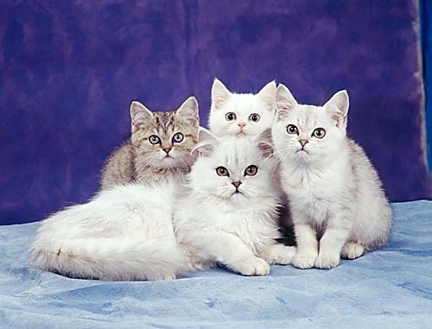
What is a family? Who is a family?

Slide 12
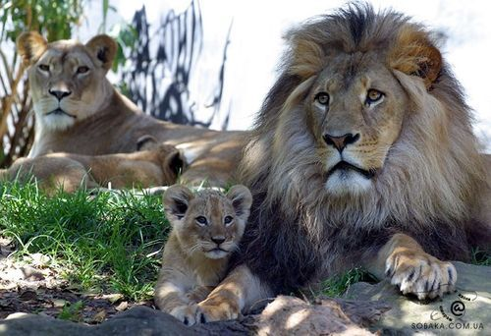
All kinds numbers can make up a family.

Slide 13
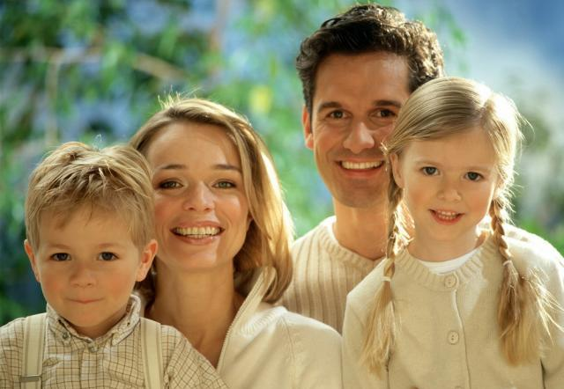

Slide 14
Home work

Slide 15
Warming up Answer the questions
Is your mother elder than your father?
Have you got a sister?
How many sisters have you got?
How old is your sister?
Have you got a brother?
What is his name?
Have you got an aunt?
You have got an uncle, haven’t you?

Slide 16
Find as many words as you can in this puzzle? Go down and across
D A U G H T E R
W H E R E B S F
Y O A R F R I A
S U U M A O S M
O N N O T T T I
N C T T H H E L
N L T H E E R Y
K E I E R R H E
S W A R X M W S

Slide 17
JOIN THE PARTS OF THE WORDS
MO TER BRO CLE
FAT THER NT MOTHER
SIS HER AU THER
FA TER UN WI
DAUGH MILY GRAND FE

Slide 18
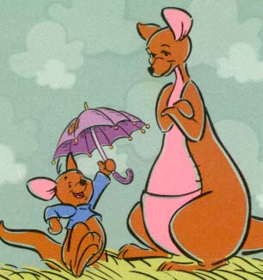
The children that lived in a shoe is a family! A pair like Kanga and Roo is a family! A calf and a cow that go moo is a family!

Slide 19
Good bye

