Slide 1
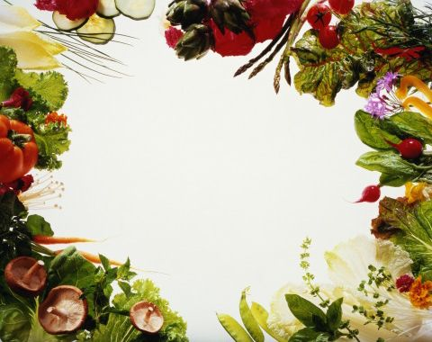
VEGETABLES of my garden
Презентация по английскому языку 3 класс. Учитель английского языка: Евсеева А.В
шг.им. С.М.Кирова.
С. Теплоключенкава
слючен.Теплоключенк

Slide 2
PEA

Slide 3
CABBAGE

Slide 4
POTATO

Slide 5
MAIZE

Slide 6
ONION

Slide 7
CARROT

Slide 8
CUCUMBER

Slide 9
PEPPER

Slide 10
TOMATO

Slide 11
SALAD

Slide 12
PUMPKIN

Slide 13
CAULIFLOWER

Slide 14
GARLIC

Slide 15
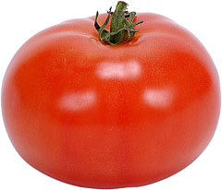
Now, I’ll read the poem about vegetables, you’ll guess it. 1. It is vegetable. It is not small. It is red. 2. It is vegetable. It is big It is green. 3. It is vegetable. It is long. It is orange

Slide 16
Let’s PLAY In our garden there are a lot of vegetables and fruits. But you should divide them into two bags. The first is for vegetables, the second is for fruits. Cucumber, tomato, carrot, pear, cabbage,apple, onion, orange, salad, lemon, pumpkin, pine-apple, apricot

Slide 17
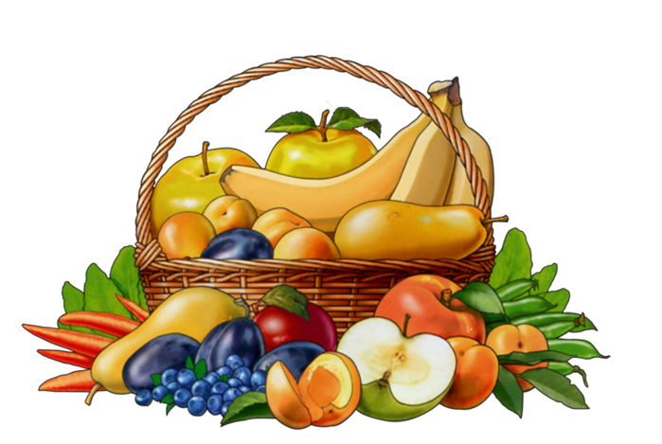
Home Work: At home you should make your own crosswords on the topic” Vegetables”.

Slide 18
The lesson is over. See you later. Good bye!

